Slide 1

Futurense
Democratizing Tech Talent to deliver impact at scale

Slide 2
Health Care Analysis

Slide 3
Overview:
Obtained the raw csv Data (census, housing, hospital, …) of Indian States from Kaggle for Analysis.
Need a Clean and Understandable Data for Analysis and Gaining Insights.
Data Processing and Data Profiling Using python and various libraries.
The scope of the problem includes :
Cleaning Census Data
Extracting Information from Housing Data.
Cleaning and Gaining Insights from Hospital Data.
Government Hospitals Requirement Analysis.
World Health Organization Standards Analysis.

Slide 4
Overview:
Given the raw csv Data (census, housing, hospital, …) of Indian States from Kaggle for Analysis.
Need a Clean and Understandable Data for Analysis and Gaining Insights.
Data Processing and Data Profiling Using python and various libraries.
The scope of the problem includes :
Cleaning Census Data
Extracting Information from Housing Data.
Cleaning and Gaining Insights from Hospital Data.
Government Hospitals Requirement Analysis.
World Health Organization Standards Analysis.

Slide 5
Tools and Technologies Used:
Visualisation tools
Seaborn
Matplot
Python And It’s Libraries

Slide 6
Libraries/Packages/Features Used:
Pandas
Numpy
Matplot
Seaborn
Date Time

Slide 7
Headline Statistics (1/2):
Average Execution Time 40 sec
Lines of Codes (LoC/KLoC) 100
Total number of functions 21
Number of built-in functions used 17
Number of user-defined functions used 5
Avg. number of lines per function 4

Slide 8
Headline Statistics (2/2):
Number of comments written 40
IDE/Code Editor Used Jupyter
Plugins Used Python Libraries, Visualization tool
Function/Complexity breakdown:
Simple Implementations 21
Intermediate Implementations 0
Complex Implementations 0

Slide 9
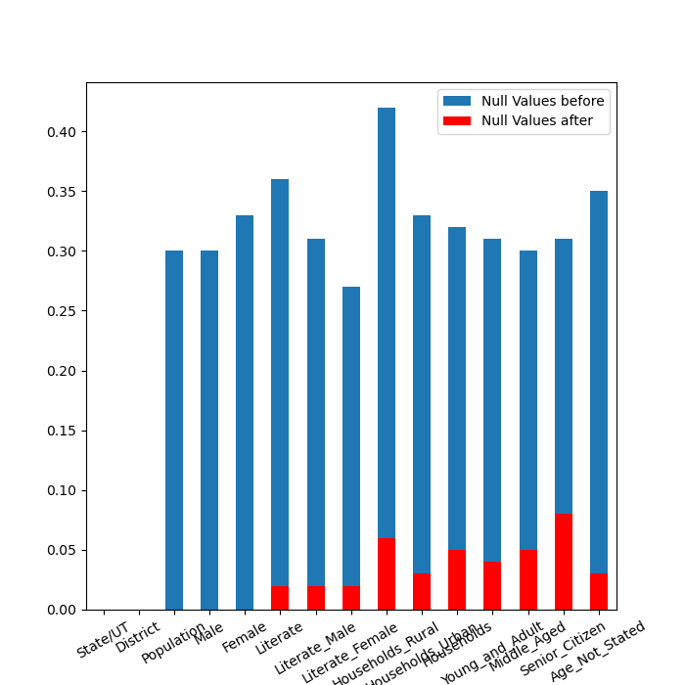
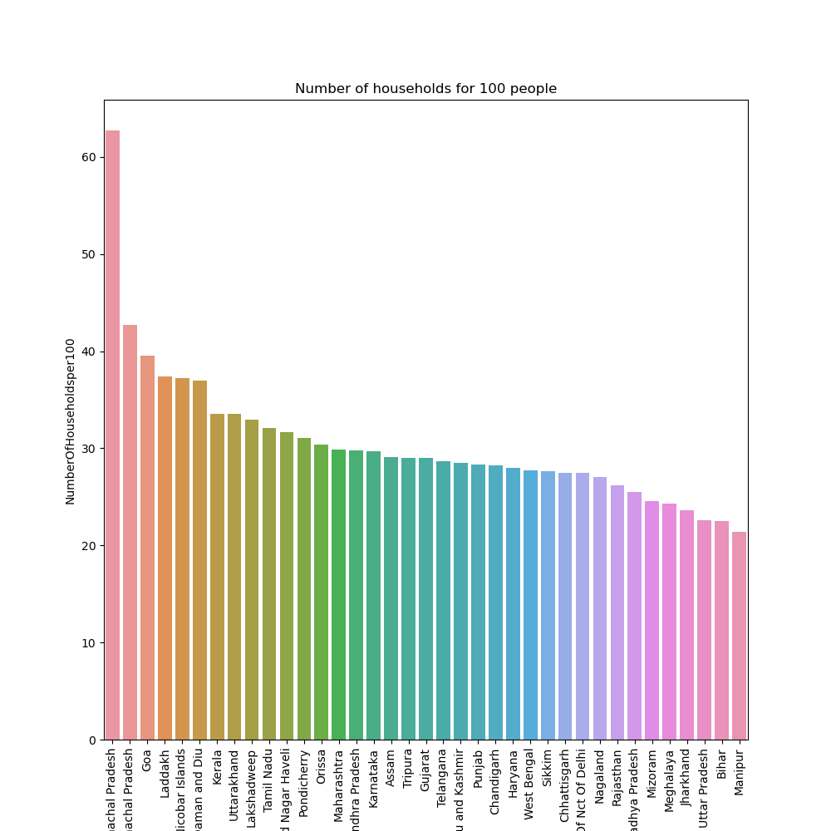
visual representations to illustrate important data groupings and extract valuable insights.
Comparison of Null Values of Census Data for each State/UT Before and After Treatment
Number of Households for 100 people in each State/UT of India

Slide 10
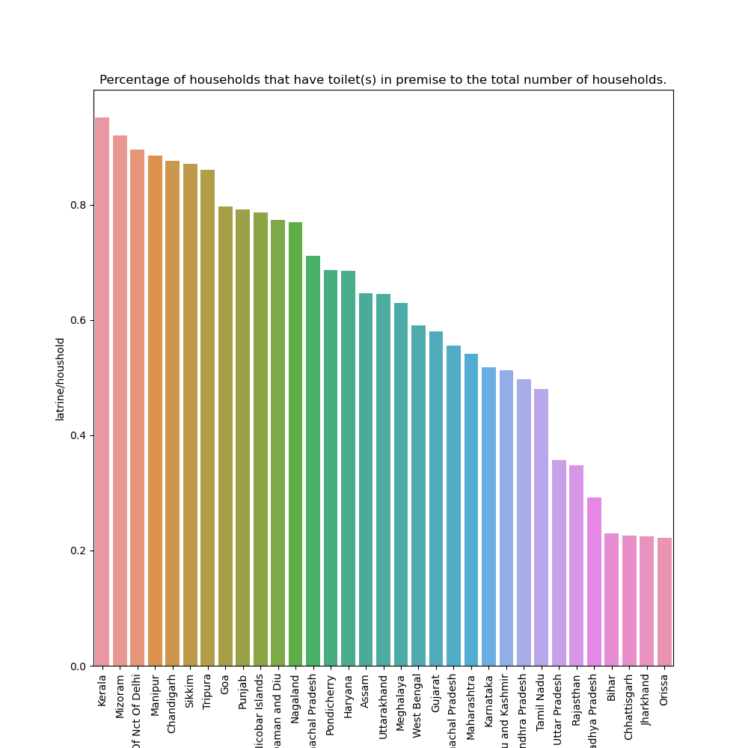
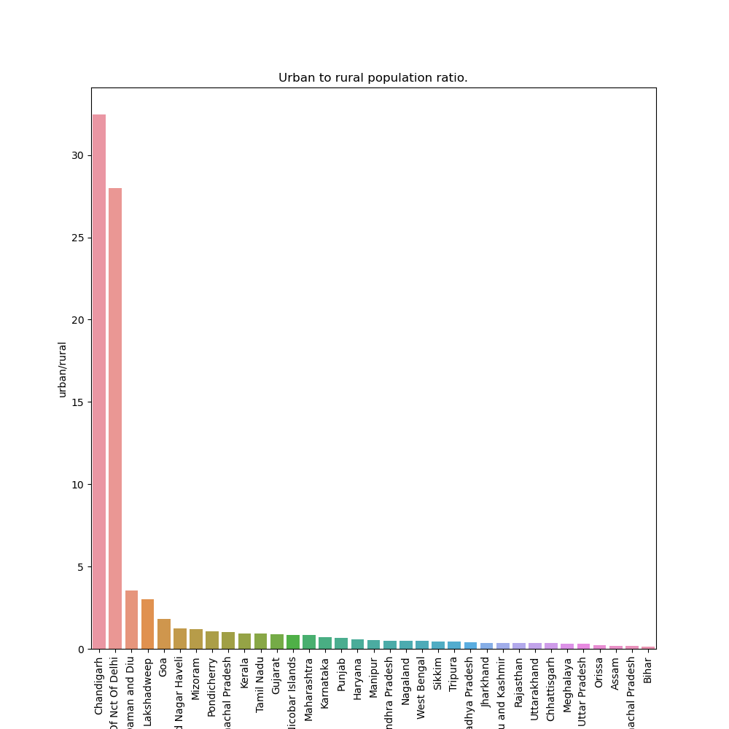
Visual representations to illustrate important data groupings and extract valuable insights.
Households having Toilet in premises to Total households for each State/UT in India
Urban to Rural Population Ratio for each State/UT in terms of Households

Slide 11
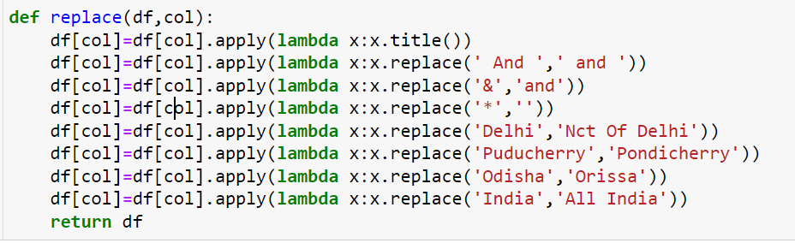
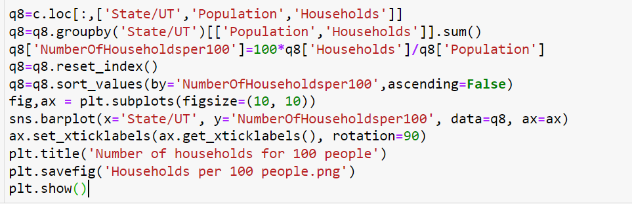
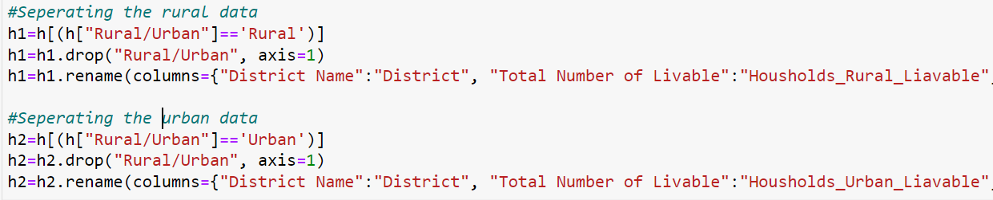
Implementation Screenshots/Code Snippets:
Some of the foundational codes that serve as the basis for the development of other codes
User Defined Function For Replacing and bringing Uniformity across Data Sets
Segregating and then merging to draw meaning full insights from Data Set
Accessing only the required Data and Grouping them and plot them visually for better understand

Slide 12
Highlights & Standout Features:
Implemented highly efficient and precise processing techniques to clean and transform the data, resulting in a seamless integration for analysis purposes.
The project emphasizes a clean and accessible approach that promotes universal understanding and effortless interpretation
We used intuitive visualizations and interactive tools that helps in exploring and gaining valuable insights from the data effortlessly.
Quality Assurance and Security of Data is provided

Slide 13
Optimizations and Best Practices Used:
Introducing User Defined Functions (UDFs) to enhance code organization and promote code reusability, ensuring greater feasibility in the project
The project strategically selected only the necessary columns, prioritizing fast and precise operations to optimize speed and memory utilization
Utilizing Powerful Visualization Tools for Enhanced Data Comprehension and Insight Generation

Slide 14
Roadblocks &Resolutions
RESOLUTIONS
Data Quality Assessment: Conducting a comprehensive assessment of data quality to identify and address issues such as missing values, outliers, duplicate records, and inconsistencies within the dataset.
Handling Missing Data: Developing strategies to handle missing data effectively, including techniques such as imputation, where missing values are estimated or replaced with appropriate values based on statistical methods or domain knowledge.
Data Standardization: Ensuring consistency and comparability by standardizing data formats, units of measurement, and categorical variables to create a unified and standardized dataset for analysis.
Data Transformation: Applying mathematical transformations (e.g., logarithmic or power transformations) to adjust the distribution of data and meet assumptions required for specific analyses, such as normality or linearity.
Data Integration: Merging and integrating data from multiple sources, ensuring data consistency, resolving conflicts, and creating a unified dataset for analysis.
ROADBLOCKS
Data Quality Assessment
Handling Missing Data
Data Standardization
Data Transformation
Data Integration

Slide 15
Future Scope:
The project's future potential lies in incorporating machine learning algorithms and predictive analytics into the data cleaning, analysis, and visualization workflow. we can develop predictive models capable of automatically detecting and resolving data quality problems, identifying patterns, making predictions, and offering valuable insights to support decision-making processes.

Slide 16
Attachments
https://github.com/dheeraj742

Slide 17
Thank You
J Dheeraj Varma

Slide 18




















